Slide 1
Battle of Neighbourhoods
Coursera IBM Applied Data Science Capstone Yash Karle, March 2021

Slide 2
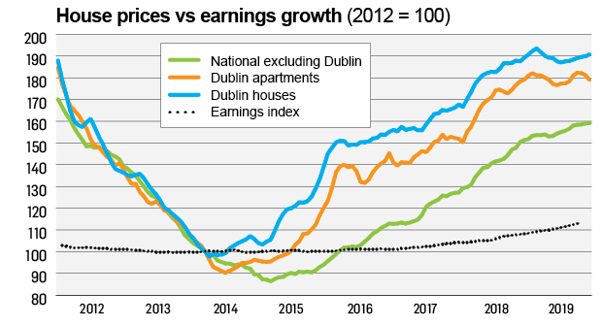
Background
Housing crisis in Dublin
House prices in Dublin have risen by almost 90 percent, while wages have increased by only 18 percent since 2012
Ireland needs an estimated 30,000 new units built annually and it’s been lagging behind for quite few years
15-minute city – impact of Covid-19
Initiative which tries to mimic 15-minute city initiative pilots in major cities across the globe
Needs of the ever-increasing urban density, enhanced public transport and investment in public realm

Slide 3
Problem
The perfect neighbourhood - 5K lockdowns
Level-5 restrictions in Ireland meant people had to restrict their movements within 5 km radius from their house.
A perfect neighbourhood in such scenarios would be able to satisfy all the “local” needs of the surrounding population in that neighbourhood.
Different neighbourhoods would have diverse demographic distribution amongst its populations.
Skewed distribution of amenities and opportunities
Focus on smaller parts of a neighbourhood (2km, 5km radius) to see if the businesses’ and retailer’s setup as part of these local towns are enough to meet the majority needs of the immediate surrounding population.
Dublin (housing crisis) the construction of houses is skewed on top of this which magnifies the gap between the demand and the supply

Slide 4
Data Sources
Daft-scraper API
We fetch all such listings and build a dataframe containing all the useful features for each property which as seen below would consist of <price', 'facilities', 'address', 'num_bedrooms', 'num_bathrooms', 'latitude', 'longitude’>
This data would help us recommend properties to the targeted end-user as well as the geographical coordinates would help us visually analyse the data in question.
Foursquare API
The challenge here is to obtain different districts comprising within Dublin City and obtain their respective geographical coordinates using Nominatim geolocator.
Construct the final dataframe where each row would be an individual venue along-with the attributes of each of the venues including their geolocation coordinates.

Slide 5
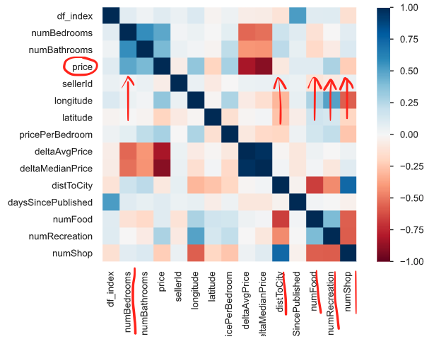
Exploratory Data Analysis
Typical (n x n) matrix where n is the number of features.
The intersecting blocks/cells in the matrix are represented as heat map which gives us an indication about the correlation between each pair of features.
Values of the correlation coefficient (as r approaches +1 the pair of features are positively correlated and likewise as r approaches -1 the pair are negatively correlated)

Slide 6
Clustering
Property characteristics: <NumBedrooms, NumBathrooms, FloorArea> [Appendix I]
D15, D16, D22 share same sized representation within Cluster 0
D9, D13 are again very similar neighbourhoods looking at Cluster 2
D6, D11, D12, D24 represent similar sizes in Cluster 4
Location characteristics: <Longitude, Latitude>
Neighbourhood characteristics: <NumFood, NumRecreation, NumShop> [Appendix II]
D2, D16, D18 share the same neighbourhood characteristics as seen from Cluster 0 all of which are south Dublin neighbourhoods. Similarly, D1, D5 can be seen as similar neighbourhoods which in turn are north Dublin neighbourhoods.
As far as the remainder of Cluster 0 is concerned, D3, D4, D6, D7, D9, D12, D14 are all fairly equal sized and stacked together. That leaves D8, D11 as the largest sized neighbourhoods within Cluster 0.

Slide 7
Conclusion
We have looked at fetching the housing data using the Daft-scraper API and joined the same with the Foursquare API
To curate some useful features which allows us to understand the interactions with price in terms of price indicators (promoters and demoters)
To know more about the different districts within Dublin city looking from multiple different perspectives – urban development, post-pandemic town planning and uplifting small businesses
Help new buyers understand the market triggers and plan their move into a potentially new neighbourhood.

Slide 8
Future Directions
Some additional explorations possible beyond the current scope of this project:
Fetch seller names from seller id and see if the data makes sense
Most common & least common venues for each neighbourhood
Removing outliers for price and then redo price deciles
Popular transport routes, commute time to city center as an influencer on price
Schools in the neighbourhood influencing house prices
Crime rates in a neighbourhood and correlation with some of the other price indicators
Pricing per sq. ft of area

Slide 9
References
Irish Time Article: https://www.irishtimes.com/life-and-style/homes-and-property/ireland-s-housing-crisis-in-five-revealing-graphs-1.4150332
Dublin Chamber of Commerce Blueprint Document: https://www.dublinchamber.ie/DublinChamberofCommerce/media/banners/Dublin_The-15-Minute-City.pdf
Daft-scraper API: https://github.com/TheJokersThief/daft-scraper
Dublin Postal Districts Wiki: https://en.wikipedia.org/wiki/List_of_Dublin_postal_districts

Slide 10
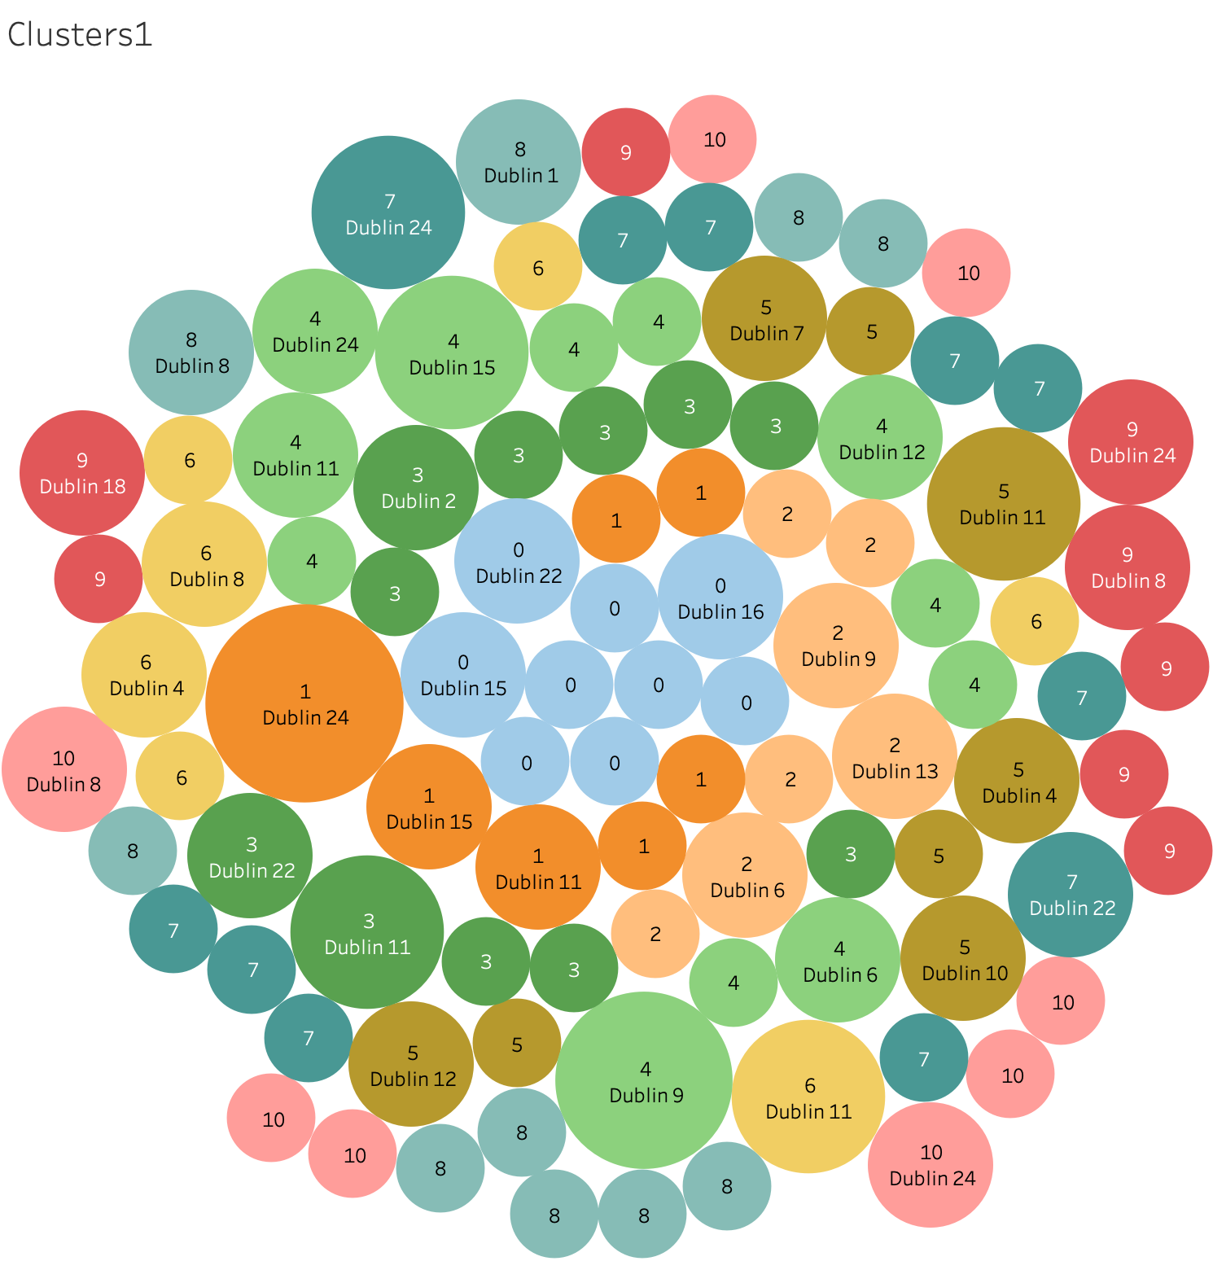
Appendix I Clusters based on Property characteristics

Slide 11
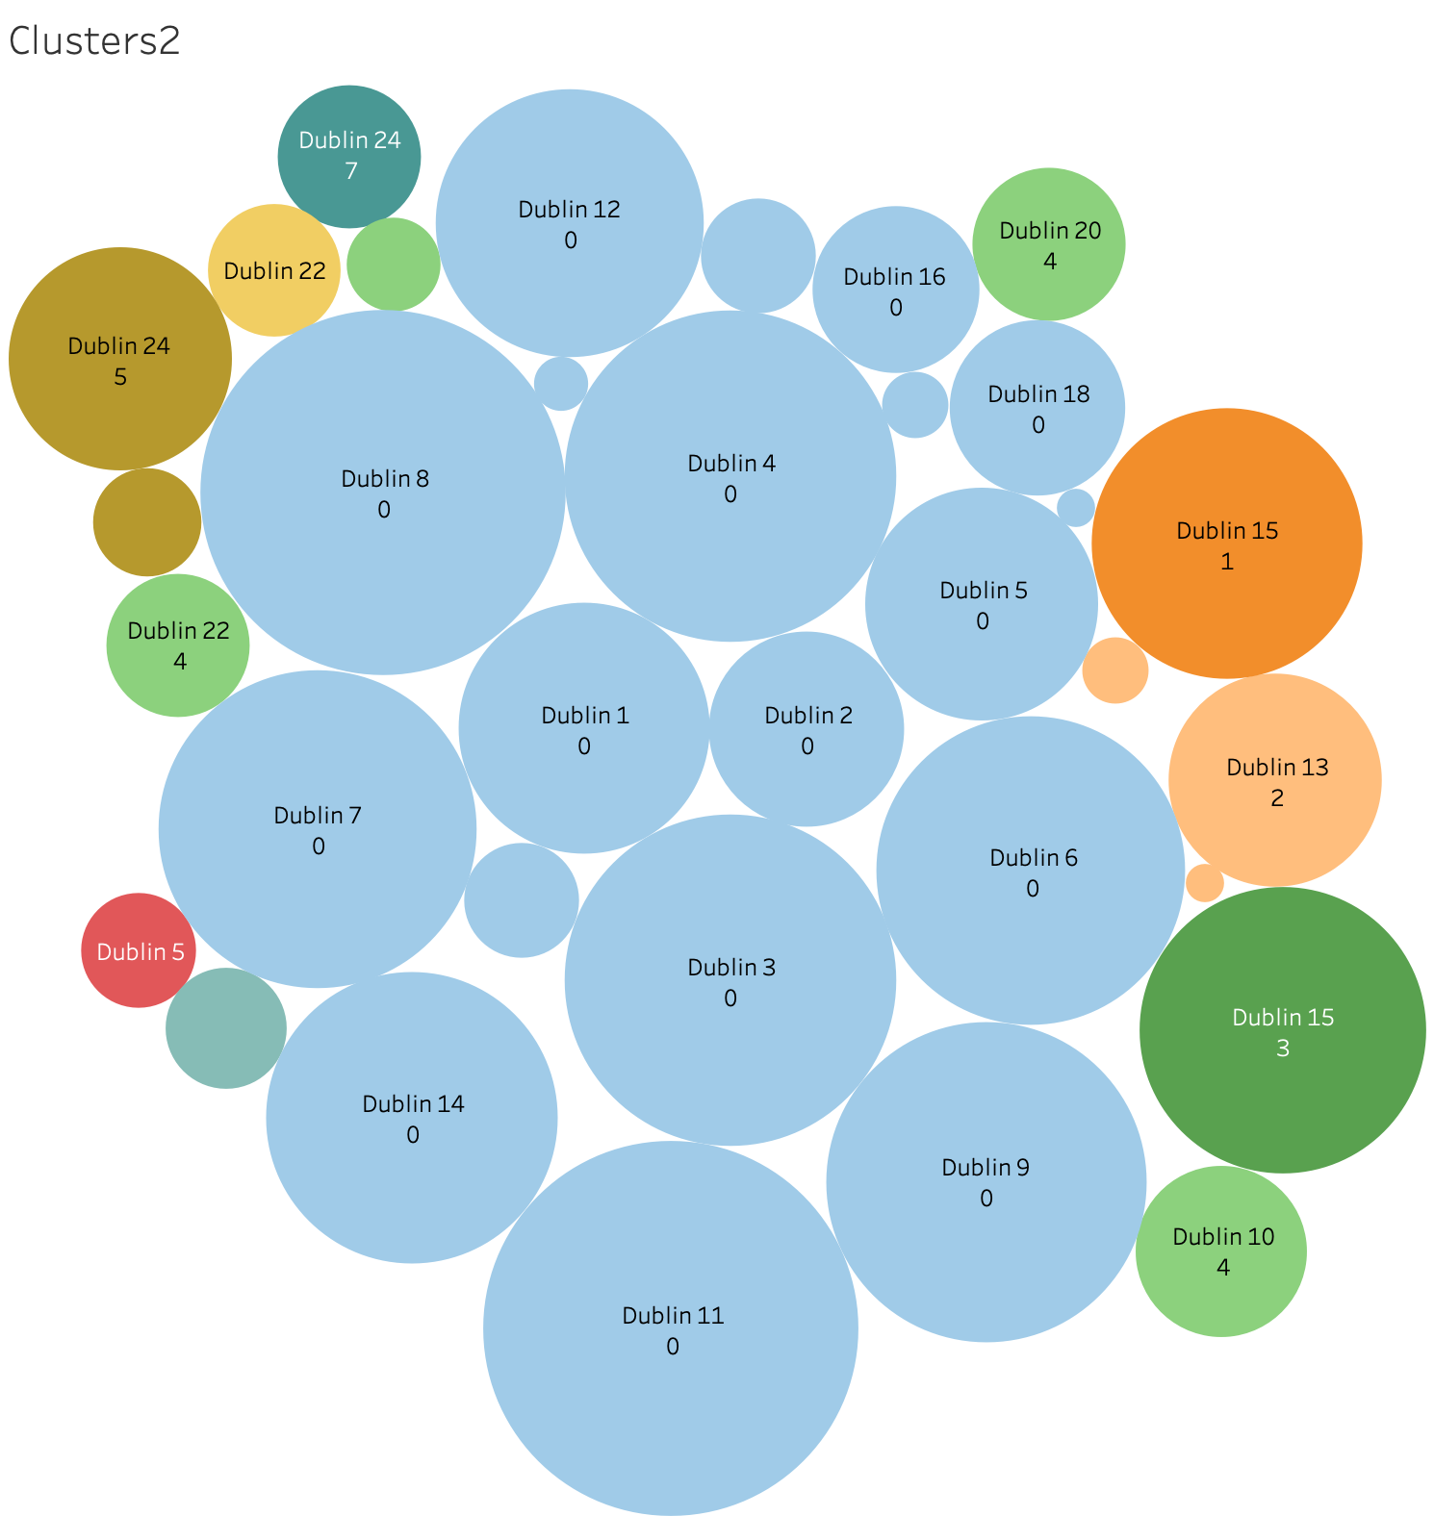
Appendix II Clusters based on Neighbourhood characteristics

